Slide 1
Behavioral Pattern
Design Pattern

Slide 2
What is Behavioral Pattern?
Providing solutions regarding object interactions
Concerned with algorithms and assignments between objects

Slide 3
What are the Behavioral Pattern
Chain of Responsibility
Command
Interpreter
Iterator
Mediator
Memento
Observer
State
Strategy
Template MEthod
Visitor

Slide 4
Chain of Responsibility Pattern
A way of passing request between a chain of objects
It will decouples sender and receiver of a request based on type of request
The base class maintains a “next” pointer
If the request needs to be “passed on”, then the derived class “calls back” to the base class, delegates to the “next” pointer

Slide 5
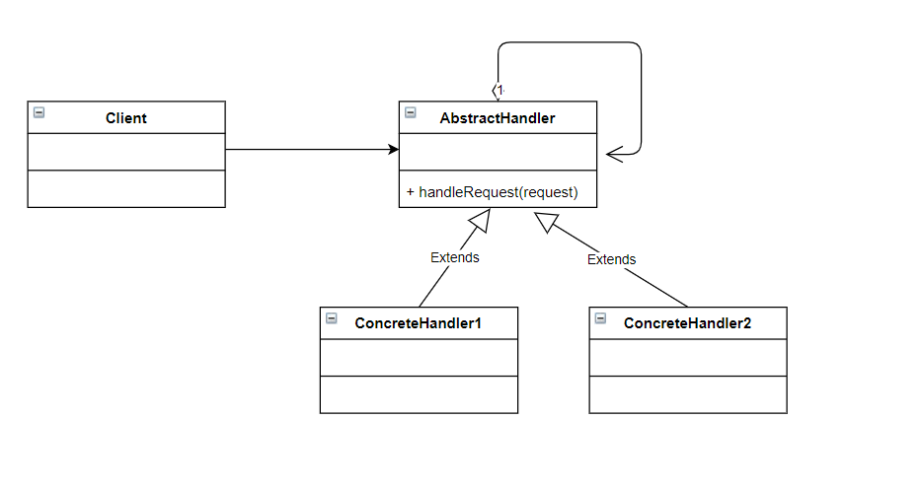
Chain of Responsibility - UML

Slide 6
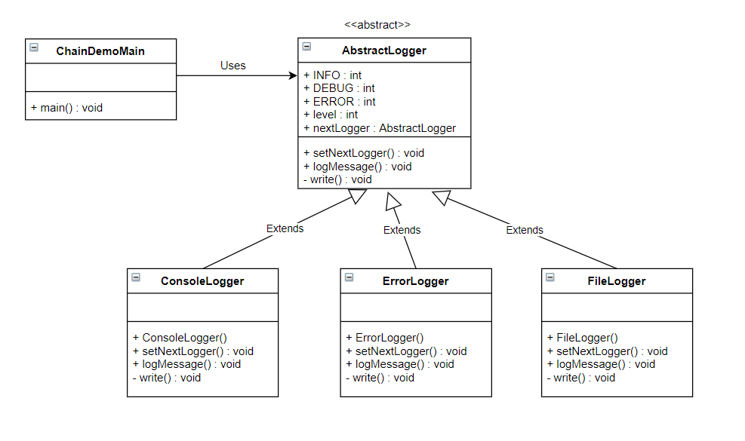
Chain of Responsibility - Example

Slide 7
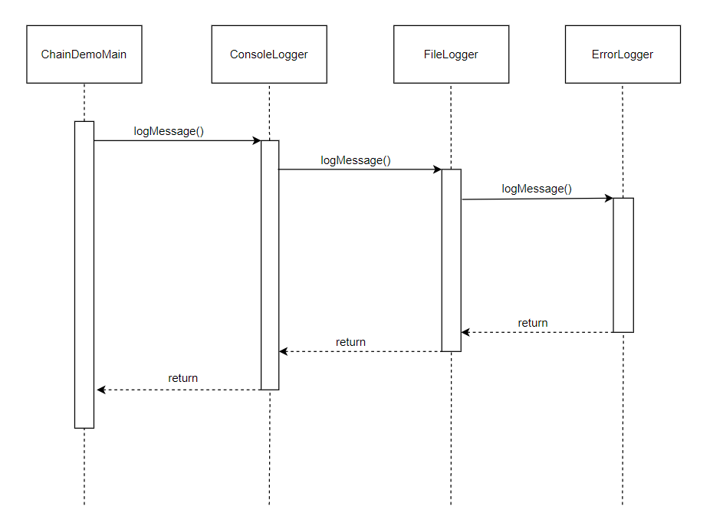
Chain of Responsibility
Sequence Diagram
Notes:
ChainDemoClass will send a request to the chain of responsibility for its processing
Then ConsoleLogger tries to process the request but unable to do it so it will relay the request to next logger class
Then FileLogger class also tries to process the request but it also unable to do it, so it will pass the request to the next logger class
Then the ErrorLogger receives the request and process it successfully, so it will send a response so that it can be relay to the previous loggers until it reaches to ChainDemoMain class

Slide 8
Command Pattern
A request is wrapped under a object as command and passed to invoker object
Encapsulate a request as an object, thereby letting you parameterize clients with different requests, queue or log requests and support undoable operations
An object-oriented callback
Method signature is “execute”

Slide 9
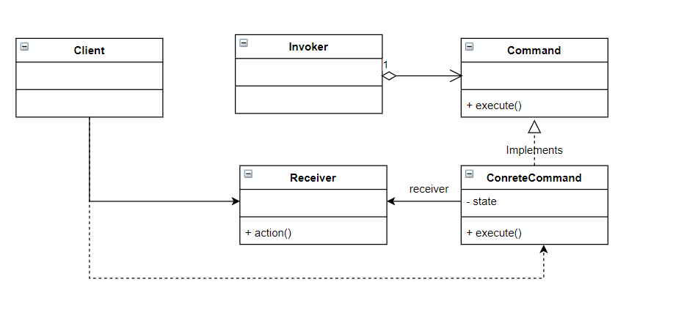
Command Pattern - UML

Slide 10
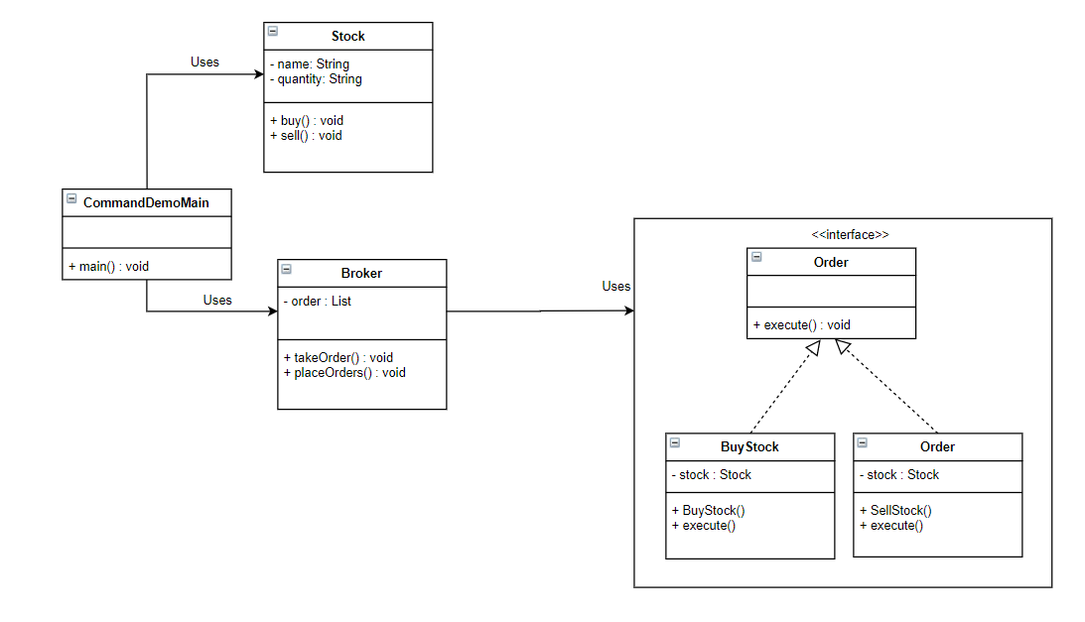
Command Pattern - Example

Slide 11
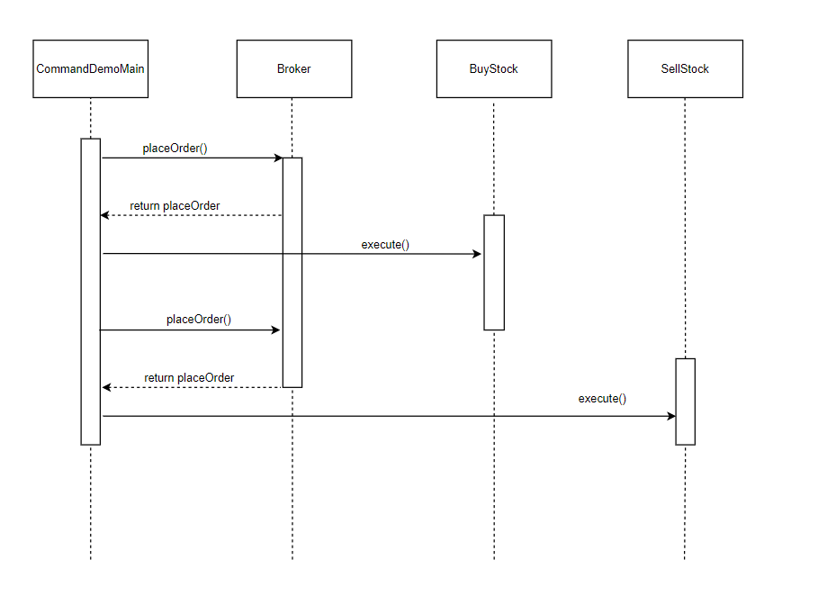
Command
Sequence Diagram
Notes:
The Broker class gets a command from CommandDemoMain class and returns it
Then the Broker class will then executes the command to BuyStock
Then the Broker class get another command from CommandDemoMain class and returns it
Then the Broker class will then executes the command to SellStock

Slide 12
Interpreter Pattern
Evaluates language grammar or expression
Commonly used in SQL parsing, symbol processing engines etc.
Define an interpret(Context) method in the Composite hierarchy
Notes:
No.3 Context objects encapsulates the current state of the input and output as the former is parsed and the latter is accumulated. It is manipulated by each grammar class as “interpreting” process transforms the input into the output

Slide 13
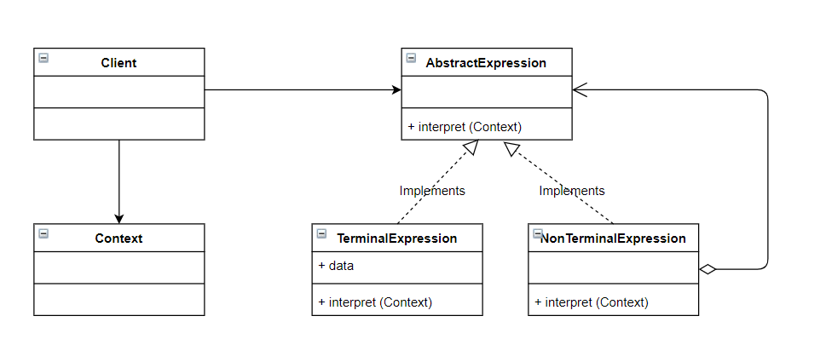
Interpreter Pattern - UML

Slide 14
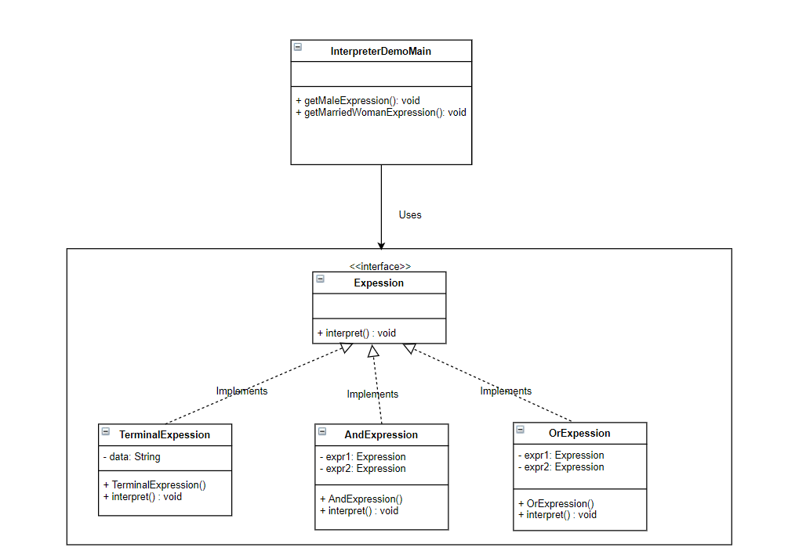
Interpreter Pattern - Example

Slide 15
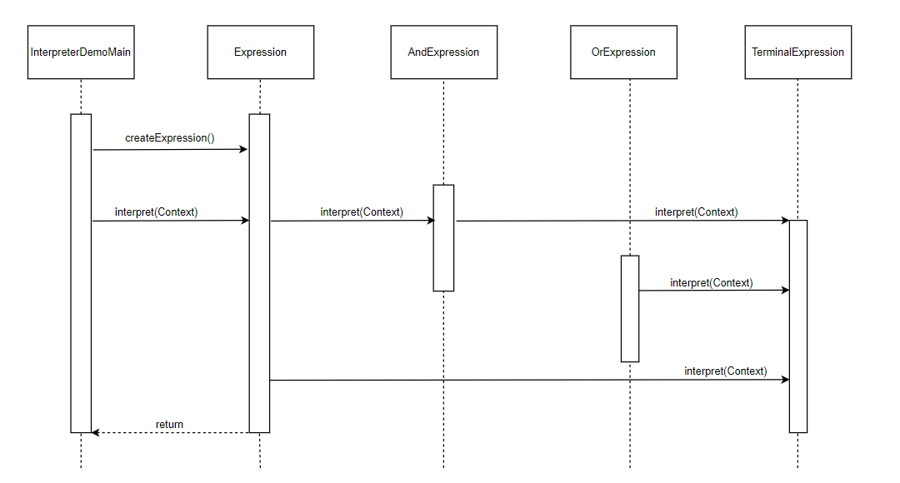
Interpreter Sequence Diagram
Notes:
InterpreterDemoMain classs creates and gets the expression to be evaluated
The client requests for the evaluation of expression to the interpreter, to the end, it sends it the context
Then the Expression class will call the AndExpression class
Then the AndExpression class will call all the Terminal Expression
Same with OrExpression
Then the Root Expression requests for the interpretation of a Terminal Expression class
Finally, Expression class is completely evaluated and provides the result of the interpretation of all the Terminal Expression and all other Expressions to the InterpreterDemoMain class

Slide 16
Iterator Pattern
Commonly used designed in Java and .Net
Used to get a way to access the elements of collection object in sequential manner without any need to know its underlying representation.
Promote a “full object status” the traversal collection

Slide 17
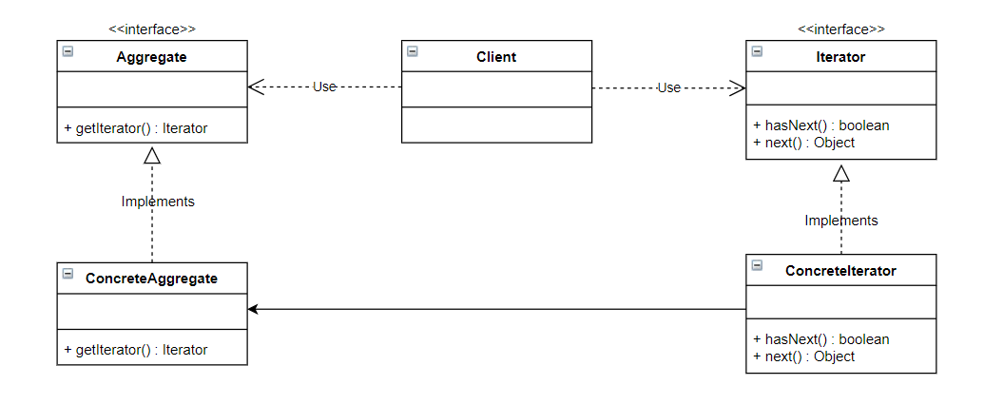
Iterator Pattern - UML

Slide 18
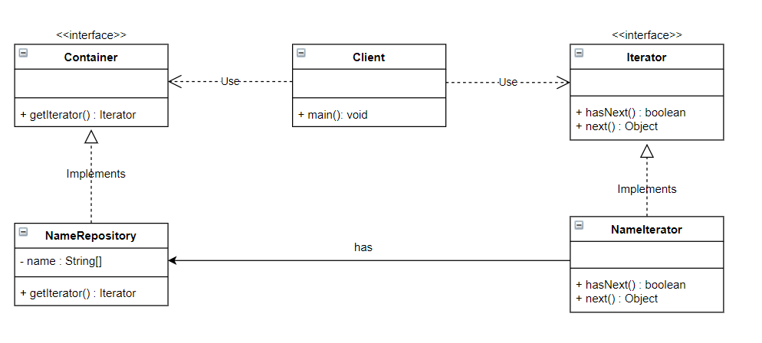
Iterator Pattern - Example

Slide 19
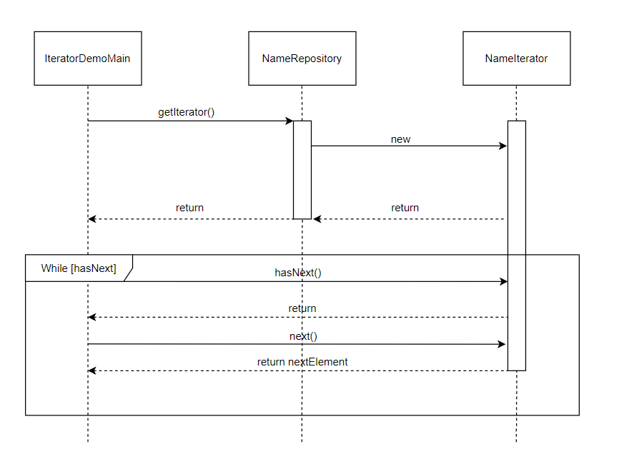
Iterator Sequence Diagram
Notes:
IteratorDemoMain class will send a request for an iterator to NameRespository class
Then NameRepository class will then create a new iterator
The clienters in a loop in order to review all elements on the structure, the loop ends when there are no elements left for reviewing, which is going to be signaled by the hasNext method.
Then IteratorDemo main class will then request a new element to the iterator using the next method
If there are still elements left to be reviewed, then we return to the step 3 (looping), something that is going to be repeated until an elements have been reviewed.

Slide 20
Mediator Pattern
Used to reduce communication complexity between multiple objects or classes.
Promote the many to many relationships between interacting peers to “full object status”
Handles the manner in which group of classes interact with each other.
Encapsulates the communication between other objects

Slide 21
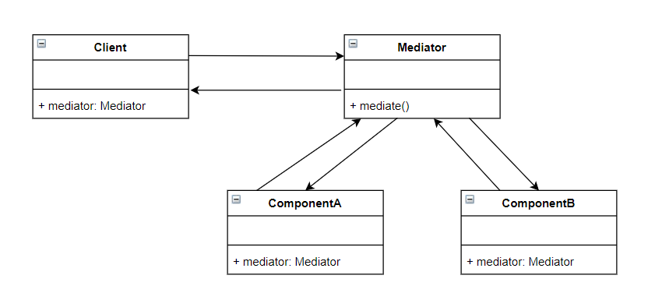
Mediator Pattern - UML

Slide 22
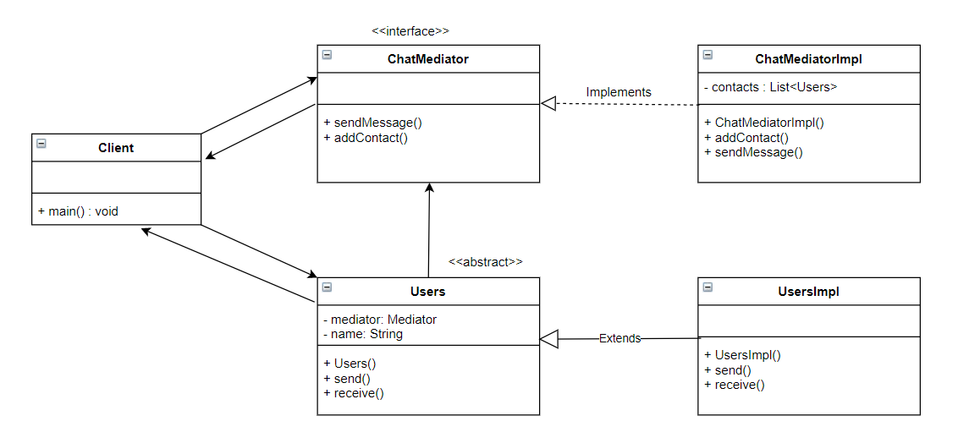
Mediator Pattern - Example

Slide 23
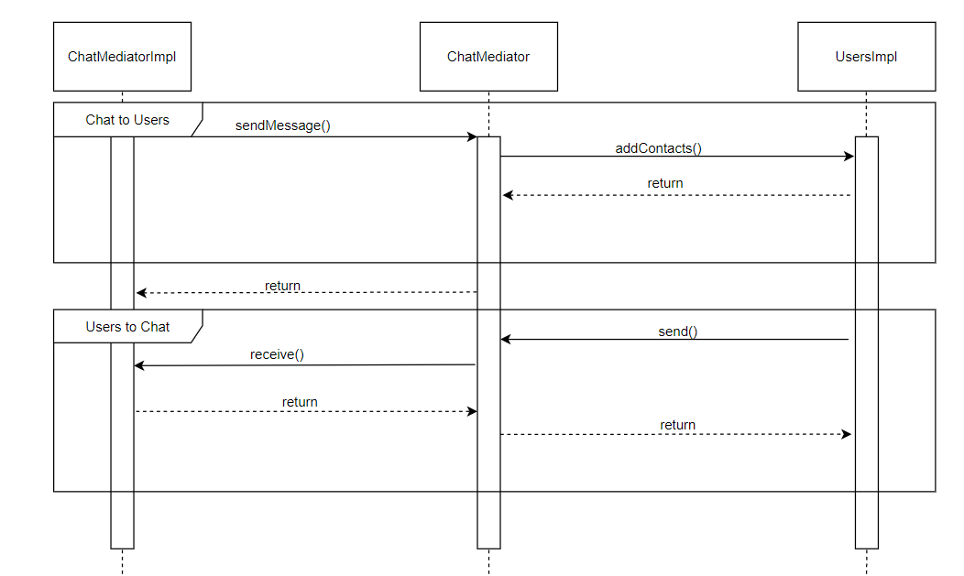
Mediator Sequence Diagram
Notes:
ChatMediatorImpl wants to communicate with UsersImpl and sends a message through ChatMediator
Then the ChatMediator class may analyze the message for debugging or tracking purposes, or for directing it to the receiver
The message receive is delivered to the receiver, which is turn sends to response to the mediator
The ChatMediatorImpl class receives the response and all directs to ChatMediatoImpl class
Likewise, the process will be reverse from UsersImpl to ChatMediatorImpl by repeating the previous steps in order to achieve a bidirectional communication

Slide 24
Memento Pattern
Allows us to record the state of an object on specific moment in order to return it to the state at any given time
Used to restore objects to previous state
A magic cookie that encapsulates a “check point” capability
Identify the roles of “caretaker” and “originator”
Notes:
Originator - the object that knows how to save itself
Caretaker- the object that knows why and when the Originator needs to be save and restore itself
Memento - the lock box that is written and read by Originator, and shepherded by the Caretaker

Slide 25
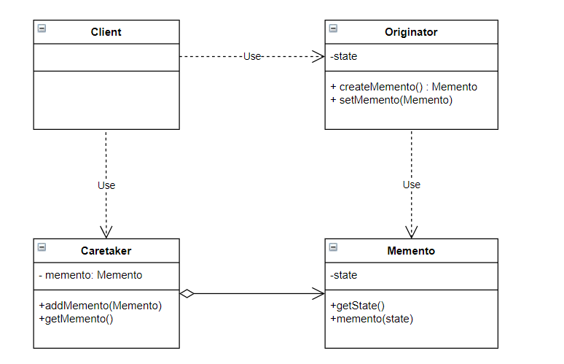
Memento Pattern - UML

Slide 26
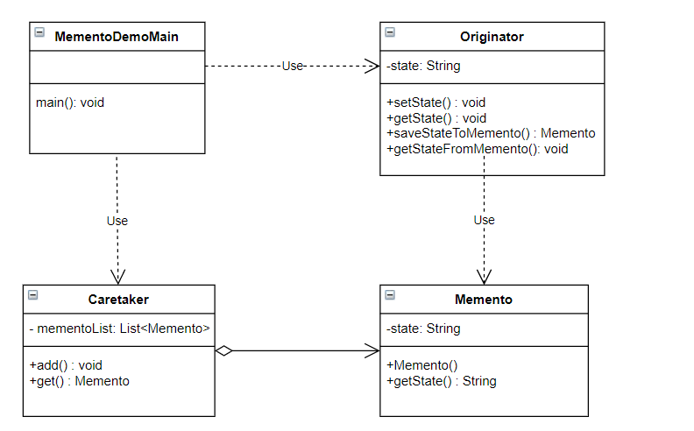
Memento Pattern - Example

Slide 27
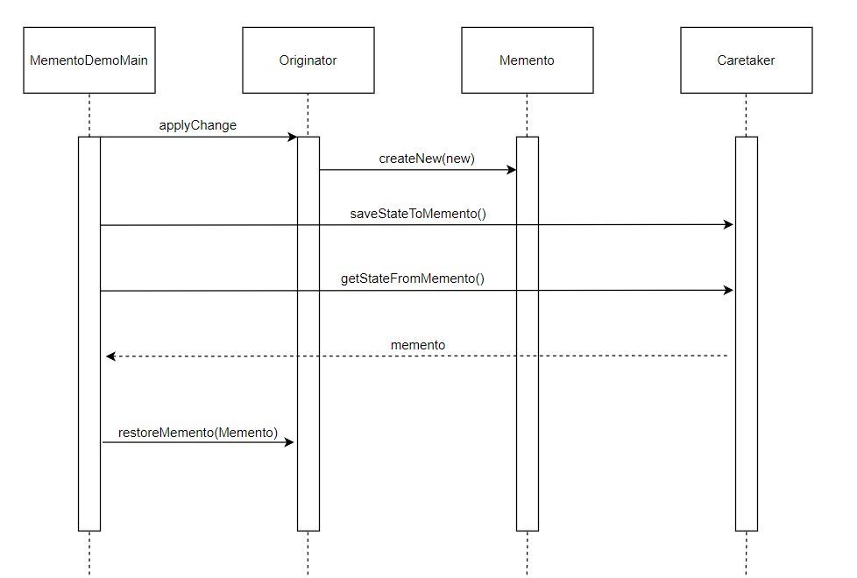
Memento Sequence Diagram
Notes:
The MomentoDemoMain class makes a change to the Originator
The Originator class creates a new Memento which represents its current state
Then MementoDemoMain class stores the Memento into the Caretaker class in order to change between different Originator state
After sometime, the MementoDemoMain class sends a request to the Caretaker class for previous state of the Originator class
The MementoDemoMain class uses the Memento sent by the Caretaker class to restore the state of the Originator

Slide 28
Observer Pattern
Define one to many dependency between objects so that when one objects changes state, all its dependents are notified updated automatically.
Differentiate between the core(or independent) functionality and the optional (or dependent) functionality.

Slide 29
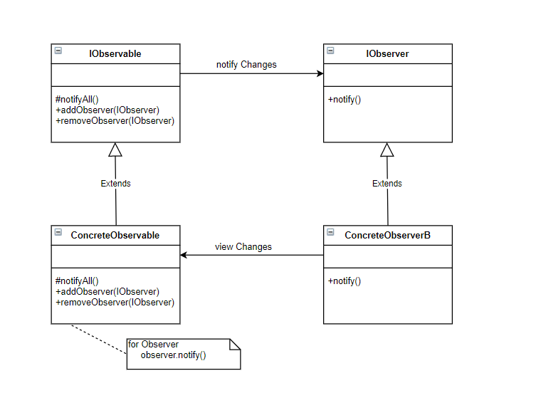
Observer Pattern - UML

Slide 30
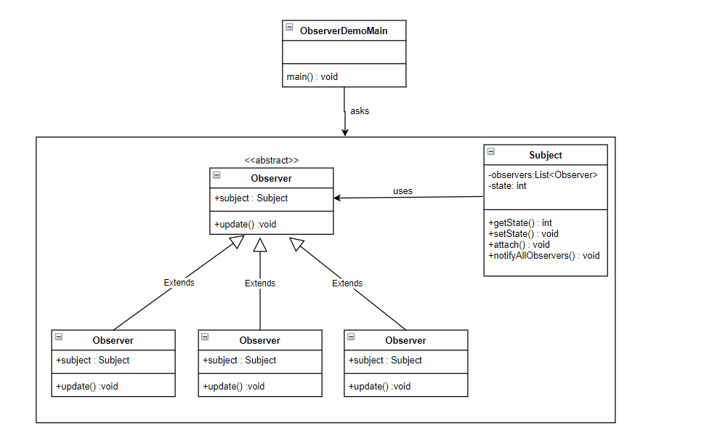
Observer Pattern - Example

Slide 31
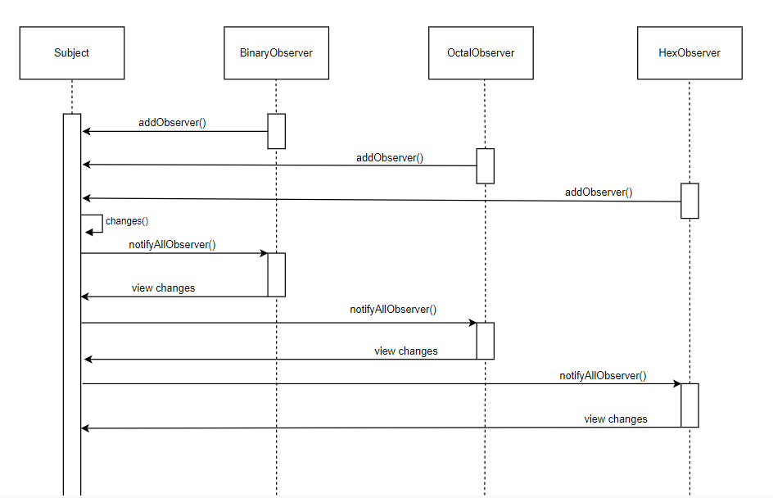
Observer Sequence Diagram
Notes:
BinaryObserver class will register into Subject class objects in order to be notified of any changes
Same thing with OctalObserver and HexObserver
When the status of the object changes
All observer class will be notified with the changes

Slide 32
State Pattern
Allow an object to changes its behaviour when there is internal changes.
Object oriented state machine

Slide 33
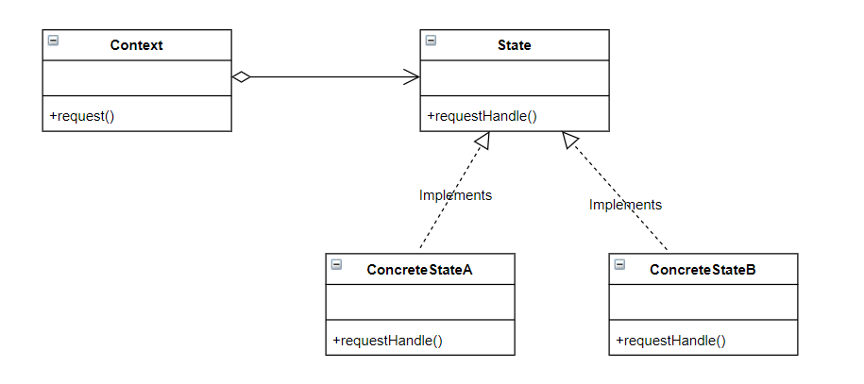
State Pattern - UML

Slide 34
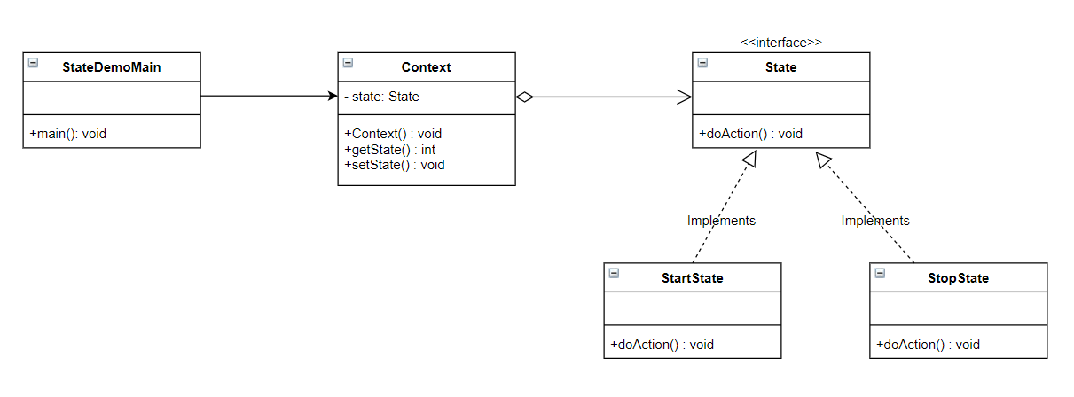
State Pattern - Example

Slide 35
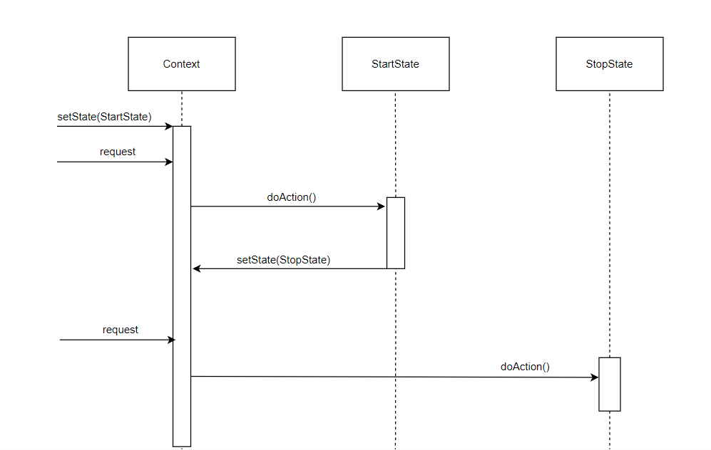
State Sequence Diagram
Notes:
A state by default will set in the Context class and this is the StartState
A request in operation is executed in Context class, delegating the execution to the current state which is the StartState
Then the execution of StartState results in a change to StopState
A new request in operation is executed in Context class, delegating the execution to the current state which is the StopState

Slide 36
Strategy Pattern
Defines family of algorithms, encapsulate each one, and make then interchangeable. Lets the algorithms vary independently from the clients that uses it.
Capture the abstraction in the interface, bury implementation details in derived class.
Notes:
In Strategy pattern, we create objects which represents various strategies and a context object whose behaviour varies as per its strategy object. The strategy object chnages its executing algorithm of the context object

Slide 37
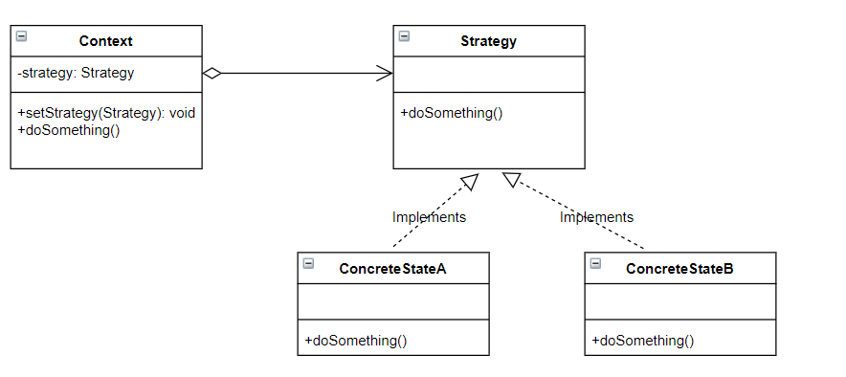
Strategy Pattern - UML

Slide 38
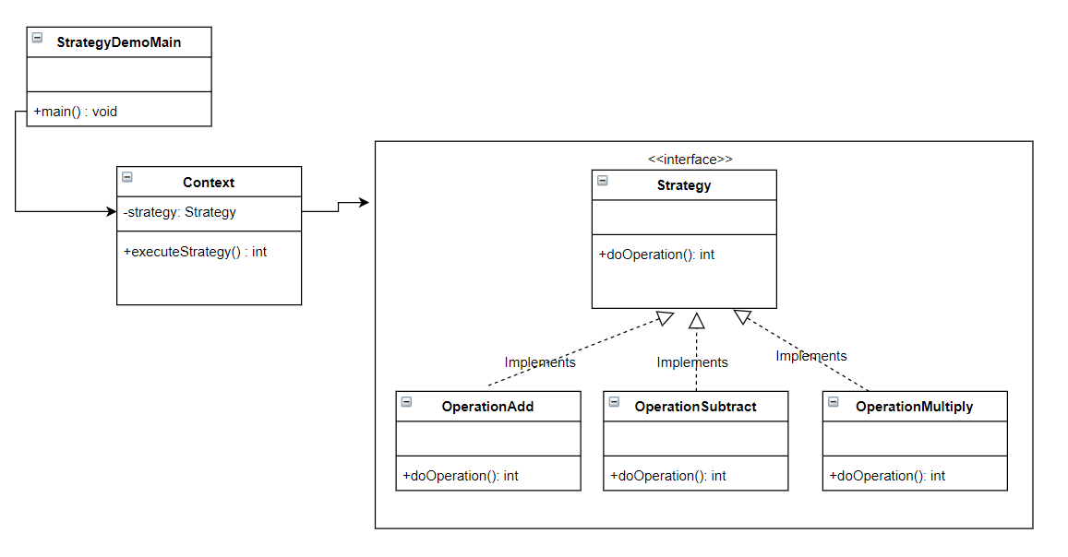
Strategy Pattern - Example

Slide 39
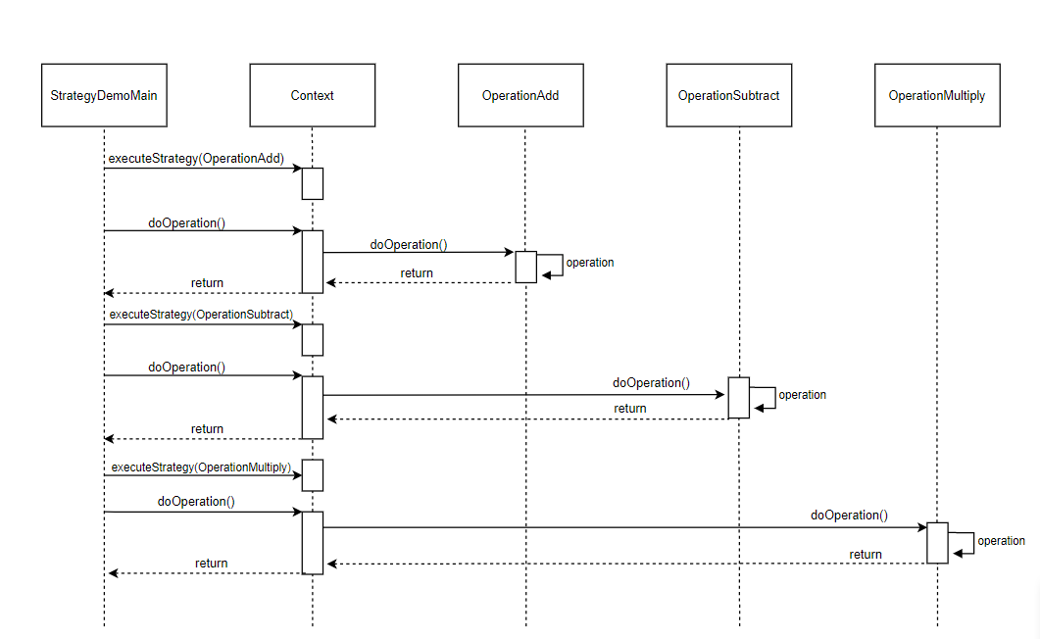
Strategy
Sequence Diagram
Notes:
StrategyDemoMain create a new context and set it to OperationAdd
Then StrategyDemoMain will then execute the doOperation
Then Context will hand this doOperation to OperationAdd class and return the result
Then Context class will take these results and hand it over to StrategyDemoMain
Same to OperationSubtract and OperationMultiply

Slide 40
Template Method Pattern
Define the skeleton of an algorithm in an operation, deferring some steps to client subclasses. Let’s subclasses redefine certain steps of an algorithm without changing the algorithm’s structure.
Base class will declare the “placeholder”, and derived classes implements the placeholder
Focuses on code reutilization for implementing steps to solve problems.
Notes:
No. 3 This is achieved by implementing base classes for defining basic behaviors. Typically, methods are created for each step of the algorithm; some of these will be implemented while others remain abstract until they are executed by the subclasses.

Slide 41
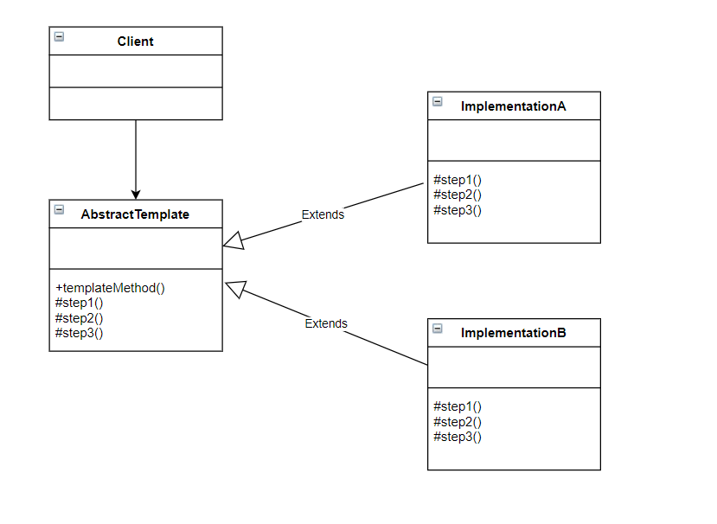
Template Method Pattern - UML

Slide 42
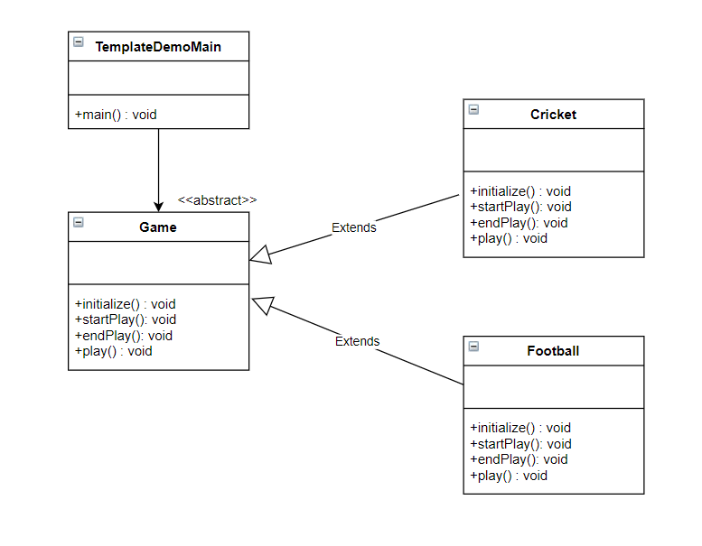
Template Method Pattern - Example

Slide 43
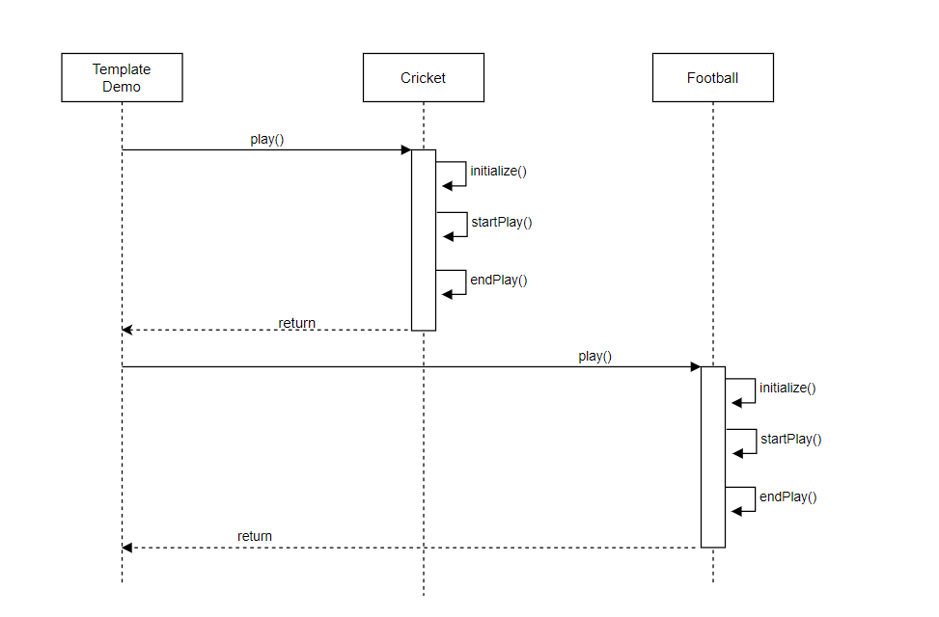
Template
Method
Sequence Diagram
Notes:
The TemplateDemo class creates and gets an instance of template implementation
TemplateDemo then executes the play operation
The default implementation of template method executes, initialize, startPlay and endPlay methods in order in Cricket class
Then the template method will then return a result to TemplateDemo class
Same with Footclass

Slide 44
Visitor Pattern

Slide 45
Vistor Pattern - UML

Slide 46
Visitor Pattern - Example

Slide 47
Visitor
Sequence Diagram

